Slide 1
HATE ME,HATE ME NOT!
HATE SPEECH CLASSIFICATION
Group No.: 11
Shivani Walecha
(9918103052)
Kshitij Srivastava
(9918103105)
Suyash Singh
(9918103172)

Slide 2
Outline
Introduction
The task - What is hate speech?
The model - How has BERT been used in this task before?

Slide 3
What is hate speech?
And how do we detect it?
‹#›

Slide 4
Does hate speech classiﬁcation matter?
“Hate speech is deﬁned as any communication that disparages a person or a group on the basis of some characteristics such as race, color, ethnicity, gender, sexual orientation, nationality, religion, or other characteristic.”
Common on the internet
Exists strong connection between hate speech and hate crimes
Could manifest into severe threats to individuals
Early detection = prevention programs
‹#›

Slide 5
And how do we detect it?
List of hate speech criteria based on critical race theory
Provides annotated dataset - Annotated into categories of sexist, racist, or neither (hate speech that does not fall in either of the previous categories)
Provide dictionary of most indicative words
Extra-linguistic features in conjunction with n-grams from dataset that contain hate speech
‹#›

Slide 6
Our Project
The objective is Analysing Text and Classifying them as Hate Speech. Segregate Datasets into Hateful class, trying to implement a MultiLingual variant for the same. Then deploying the model on a user-friendly interface to create an application.

Slide 7
Why has research been limited?
Hate speech is complex
Racial/sextist slurs are easy to identify
Does hate speech always contain slurs or bad language?
Human identiﬁcation/annotation is complicated
Deﬁning hate speech is diﬃcult
Not uniform across all demographics -- different levels of knowledge/exposure
People’s opinions are biased
Similar to identifying privilege, requires critical thinking process and clear decision list
Unclear how to handle inter-annotator disagreement
Stress for human annotators

Slide 8
Speech is offensive if it...
Uses a sexist or racial slur
Attacks a minority
Seeks to silence a minority
Criticizes a minority
Without a well founded argument
Promotes (but does not directly use) hate speech or violent crime
Criticizes a minority and uses a straw man argument
Blatantly misrepresents truth or seeks to distort views on a minority.
Shows support of problematic hashtags.
Negatively stereotypes a minority

Slide 9
Read about similar projects and research papers.
Made a shared repository to facilitate code sharing and team coordination.
Read the documentation and the various Research Papers discussing the classification of Hate Speech.
Added a readme for explaining the basic working and structure of the project and the dependencies on external libraries that are required.
Obtained a Few Dataset that seem usable for the project.
Studied and Analysed the various machine learning and Natural Language Processing models and approach that can be used for classifying and analysing hate speech like CNN+GRU.
The Dataset was downloaded and preprocessed to remove symbols, emoji and other non essential characters from the text sample.
PROGRESS

Slide 10
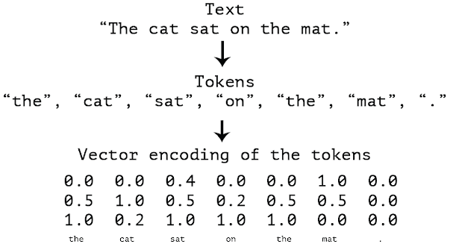
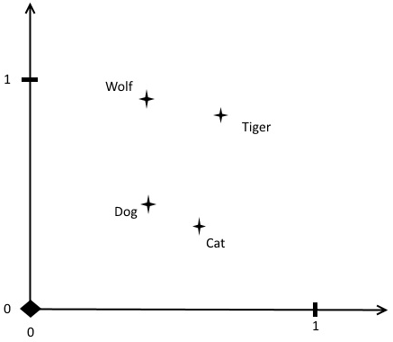
Vector Text Embedding
This was done using the Glove-gigaword replacing the previously word2vec approach to embedding for the words to create corpus. While the Bert model was used for the sentence embedding.

Slide 11
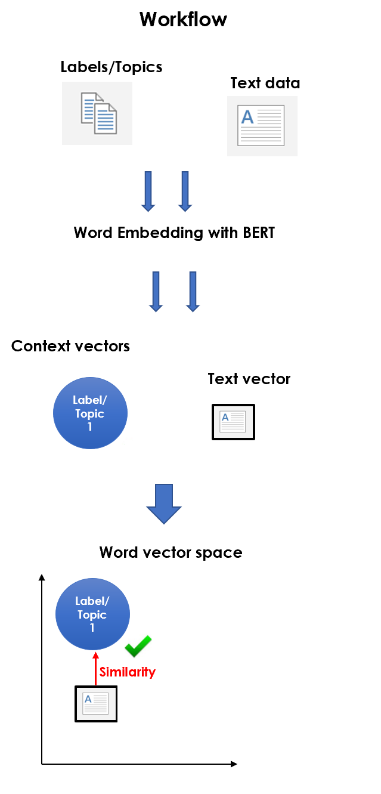

Slide 12
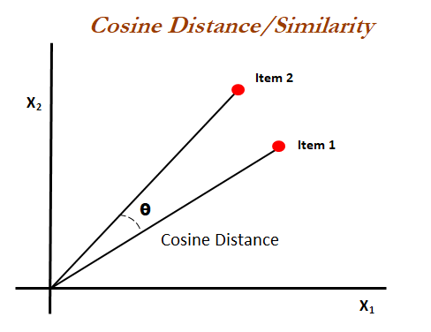
Result

Slide 13
Cosine similarity is a measure of similarity between two non-zero vectors of an inner product space. It is defined to equal the cosine of the angle between them, which is also the same as the inner product of the same vectors normalized to both have length 1.

Slide 14
Using the gensim api to find similar words to hate speech words like ‘hate’, ‘racism’, slur words.
Using the similar words list and the bert model, we calculate the probability of a text being hate speech.
Accuracy > 70%

Slide 15
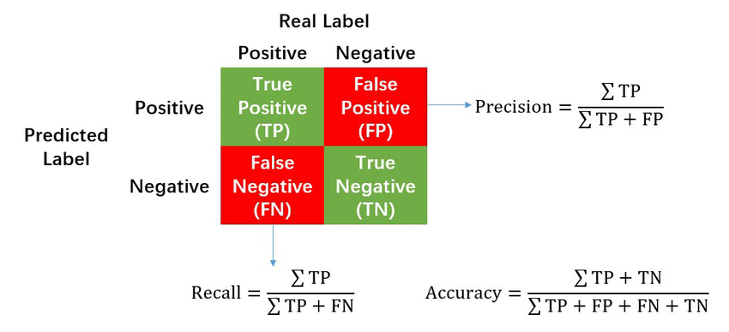
The Precision is 84%, Recall is 83% and Accuracy is 73% after trial error we get best Accuracy at 0.50 similarity threshold i.e every value above 0.5 similarity will be retrieved.

Slide 16
CONCLUSION
Now what is left is to Segregate Datasets into different categories in accordance with multiple aspects like Offensive, Hateful, Racial, Gender on an unlabeled dataset followed by a multilingual implementation possible on the available datasets.
Then deploying the model on a user-friendly interface to create an application which scrapes relevant data from the newfound text inputs and attempts to mark it as spam and remove it.
The application in general will require a scraper which will utilize the data from the site and then add to a cache of input which will be passed into the hate speech classifying algorithm we are using at the same time trying to achieve the best accuracy.

